Slide 1
Java Game Development
By Support Game Committee

Slide 2
Who am i ?
Student at FCIS Ain Shams at Department Of Software Engineering
Game Head at Support Game Committee
Game Development enthusiast

Slide 3
Session Points
Overview of java GUI tools and game engines
Main game development concepts
Game loop
Transformations, coordinate & vector math systems
Models and Render Pipeline
Animations and Character Rigging
Materials: Color, Lighting/Shading
Camera perspectives in games
Physics: Gravity, Collisions, Forces in games
OOP in game development
What's next ? / where to go from here ?

Slide 4
What you will learn ?
How to start developing games in java
Understand how video games work and the logic behind it
Why is oop important in game development
What to do next to make a great video game using java

Slide 5



Java Game Development Tools and libraries

Slide 6
Engine Capabilities
Blender support, Importing a 3D Model.
3D File Importer
Material/Shader Editor
3D Scene Composer
Code Palette
Terrain Editor
Light and Shadow
Filters and effects
Input
Physics
Cinmatices
Networking
Gui
Notes:
Java based, open sourced, cross platform 3d game engine that runs on most Java supported platforms.
Can target Windows, Linux, Mac and Android, with iOS and Oculus VR support currently being tested.
it can be used in library form if you prefer working in Eclipse or IntelliJ. You will however lose access to some very convenient tools.
but they basically boil down to having an OpenGL 2 compatible video card and JDK 6 or higher installed.
While jMonkeyEngine supports the Ogre XML format and Blend files, working with a game oriented file format is almost always the best performing option. Fortunately jMonkeyEngine provides just such a format, j3o.
this is actually a preconfigured version of the Netbeans IDE with a set of plugins and extensions to support jMonkeyEngine development. This means in addition to the various jME tools you get a complete modern Java development environment, meaning code completion, project management, refactoring tools, debugging and more

Slide 7
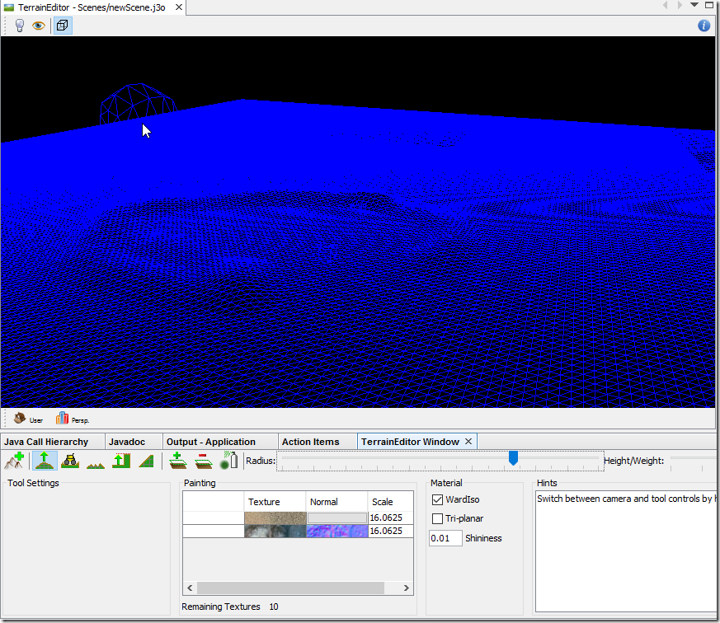
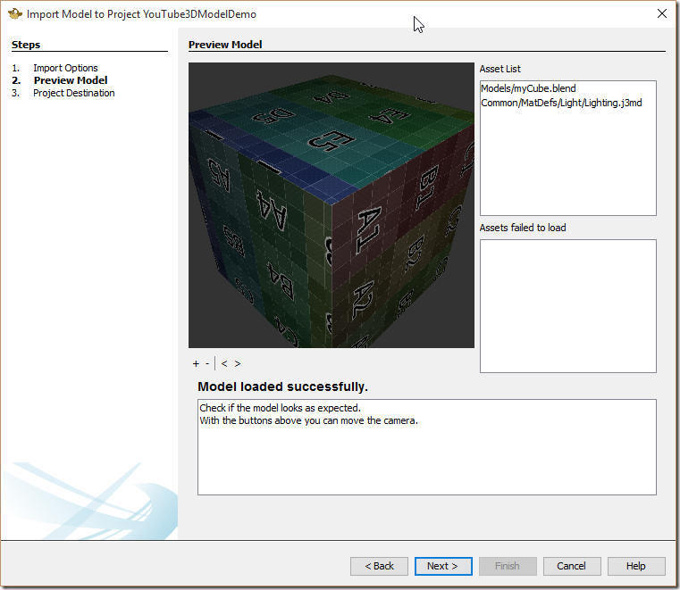
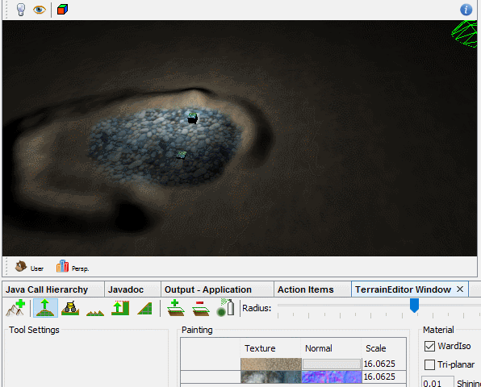
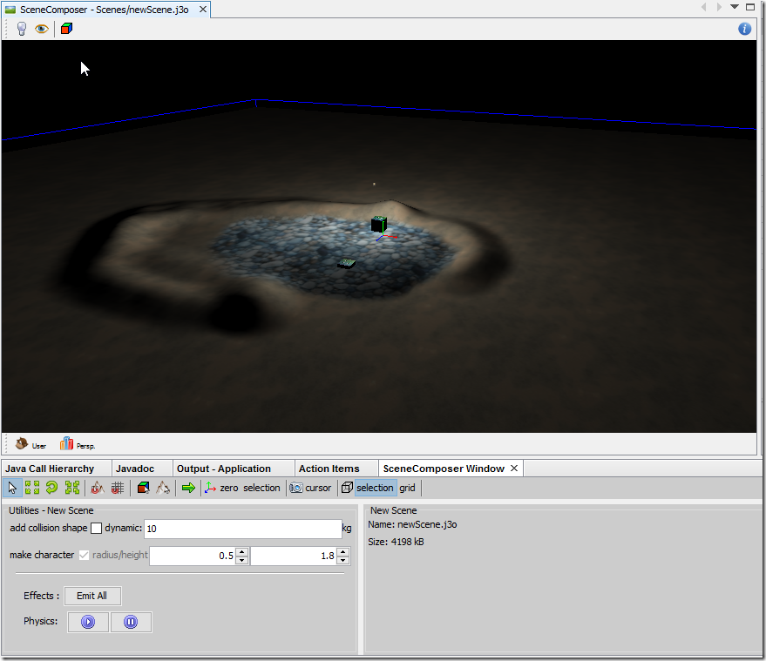
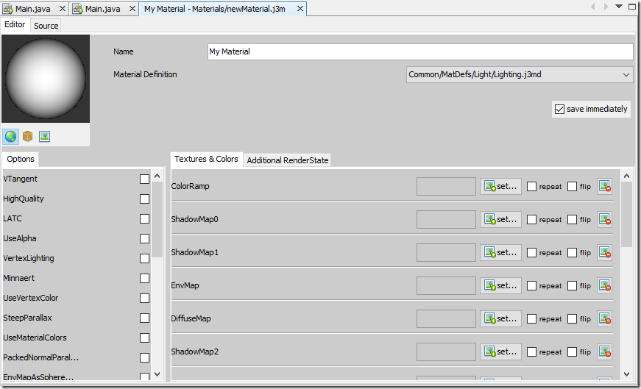
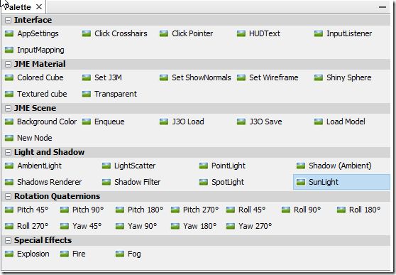

Slide 8
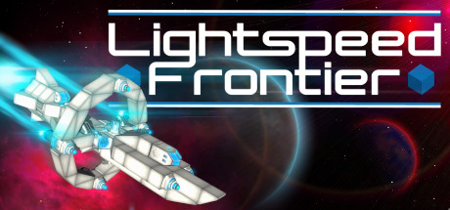
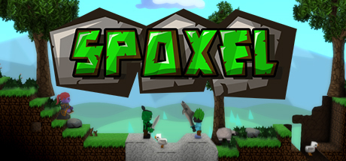

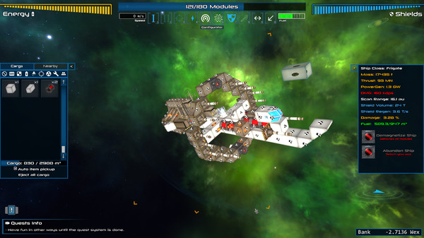
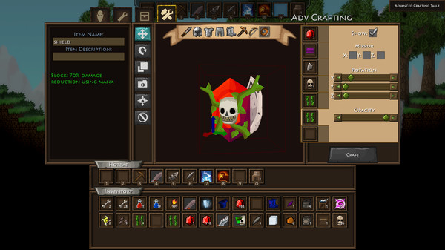
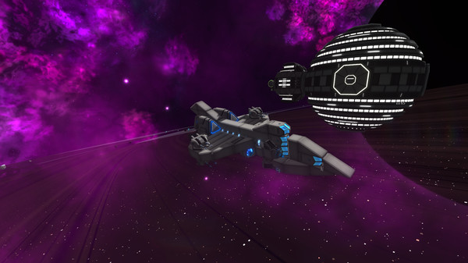
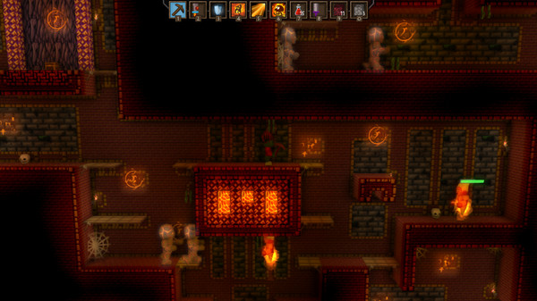
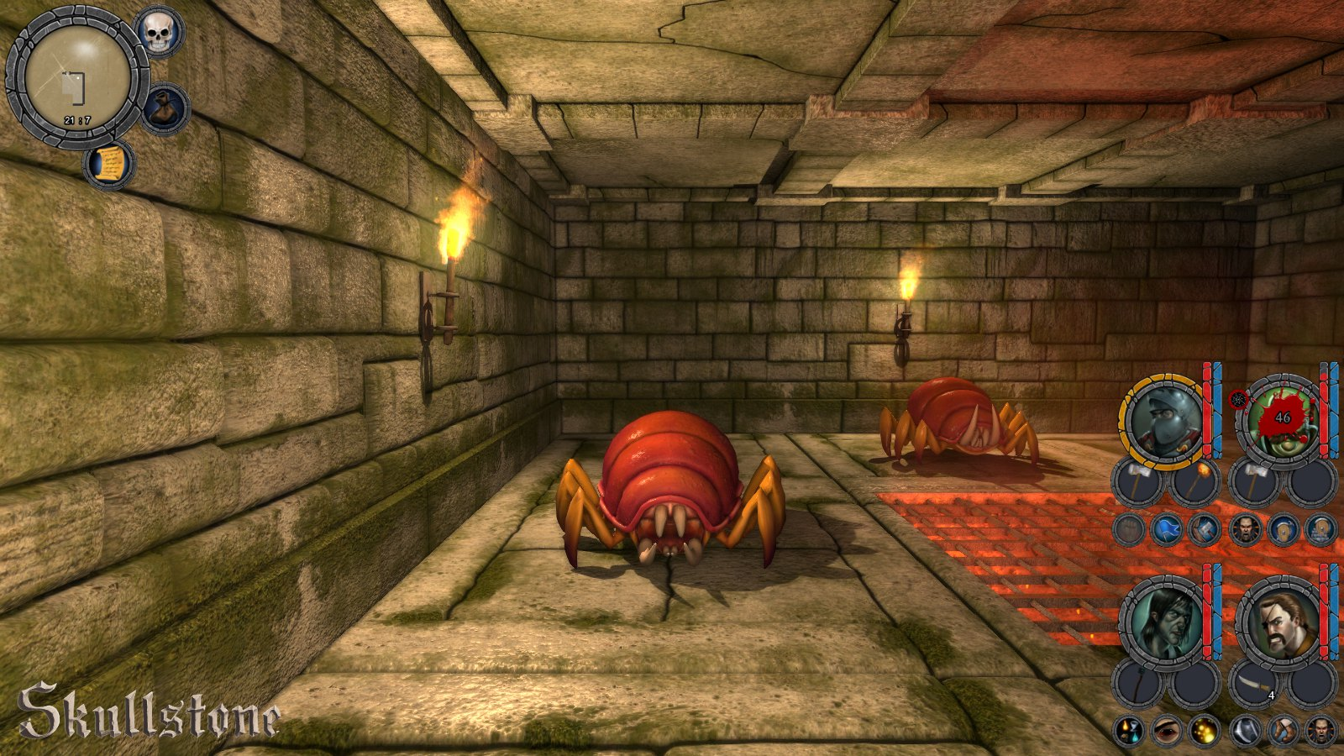
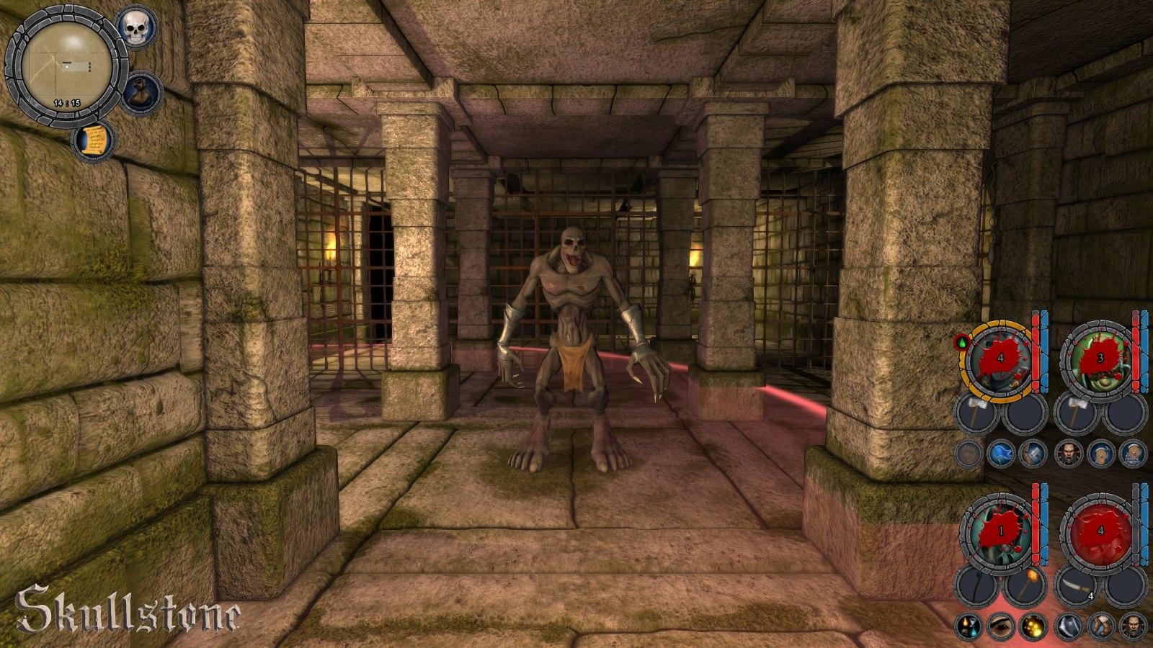
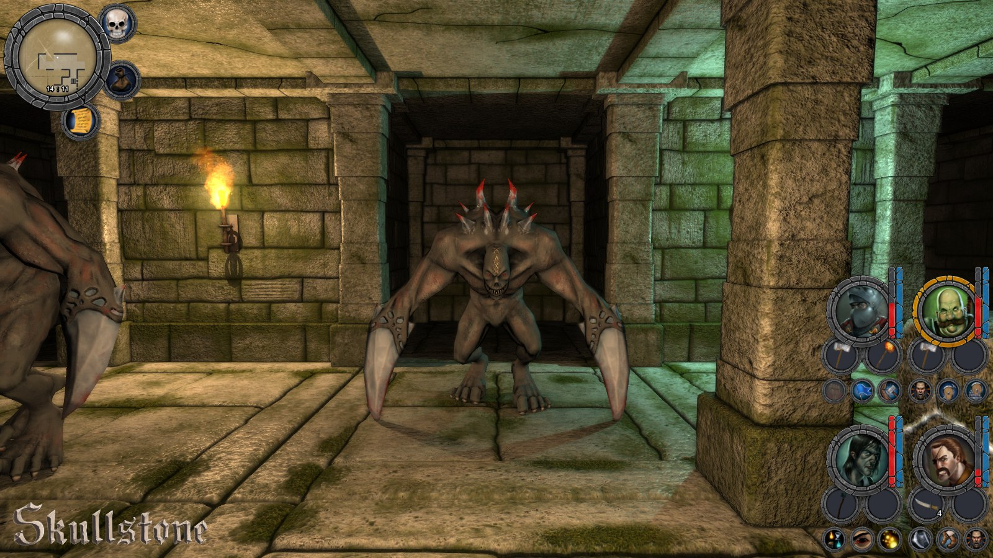
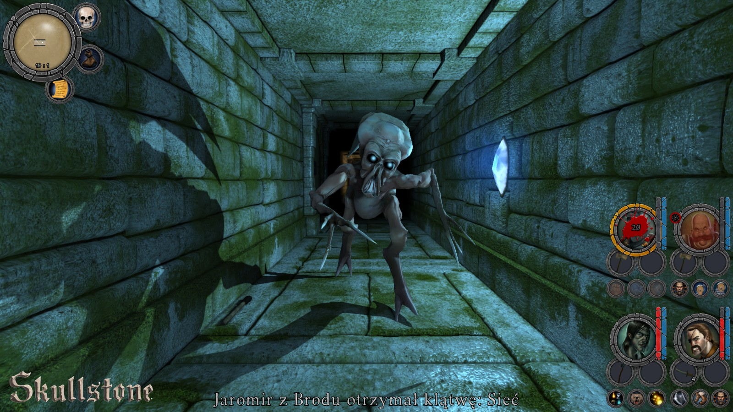
jMonkey Game Examples

Slide 9

library
Capabilities
Cross-Platform
Windows, Linux, Mac OS X, Android (2.2+), BlackBerry, iOS, Java Applet (requires JVM to be installed), Javascript/WebGL (Chrome, Safari, Opera, Firefox, IE via Google Chrome Frame)
Graphics
High-level 2D APIs, High-Level 3D APIs.
Audio, File I/O & Storage
Input Handling
Abstractions for mouse and touch-screen, keyboard, accelerometer and compass
Gesture detector, detects taps, panning, flinging and pinch zooming
Math & Physics
2D physics: JNI wrapper for Box2D physics. So awesome, other engines use it as well
3D physics: JNI Wrapper for bullet physics
Notes:
Hiero is a tool for creating bitmap fonts from system/ttf fonts
The Particle Editor is a GUI tool for creating particle systems
Overlap2D A 2D level and UI editor for LibGDX games built over LibGDX
GDX-Proto A 3D game engine built over LibGDX
BDX Another 3D engine built over LibGDX, this one built over top of Blender as the world editor.

Slide 10
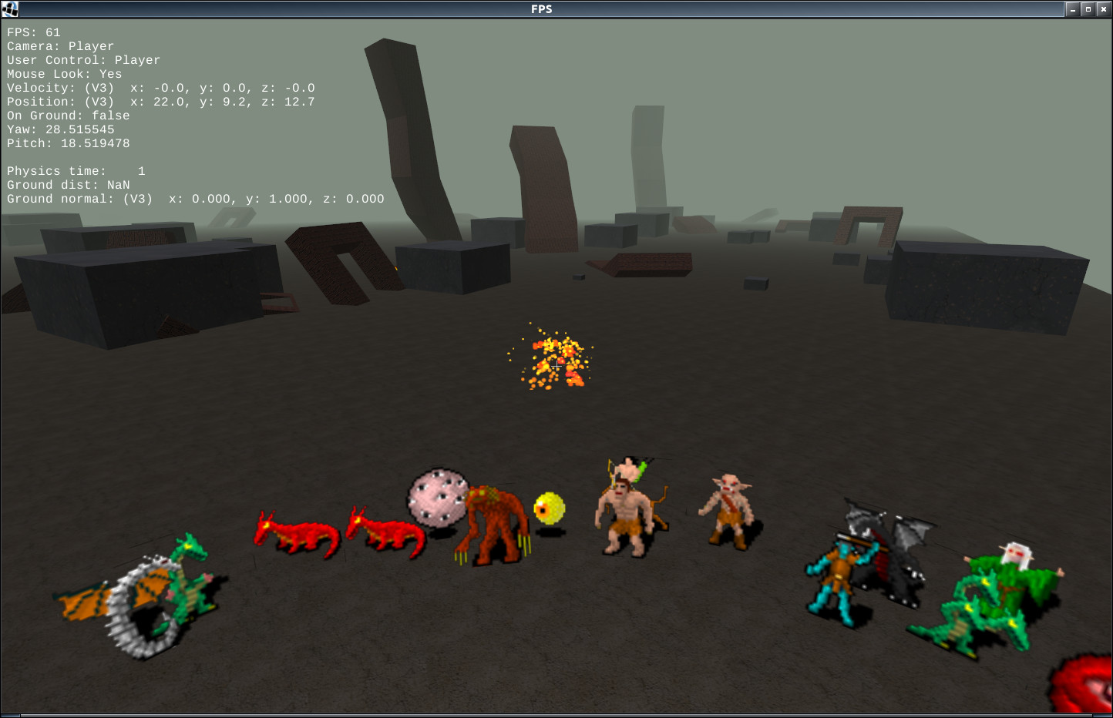
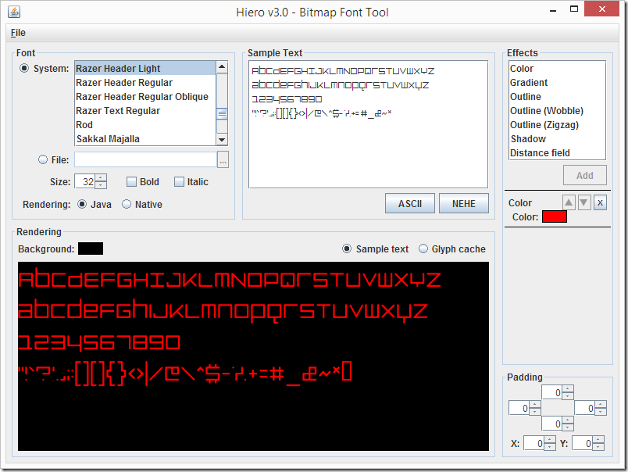
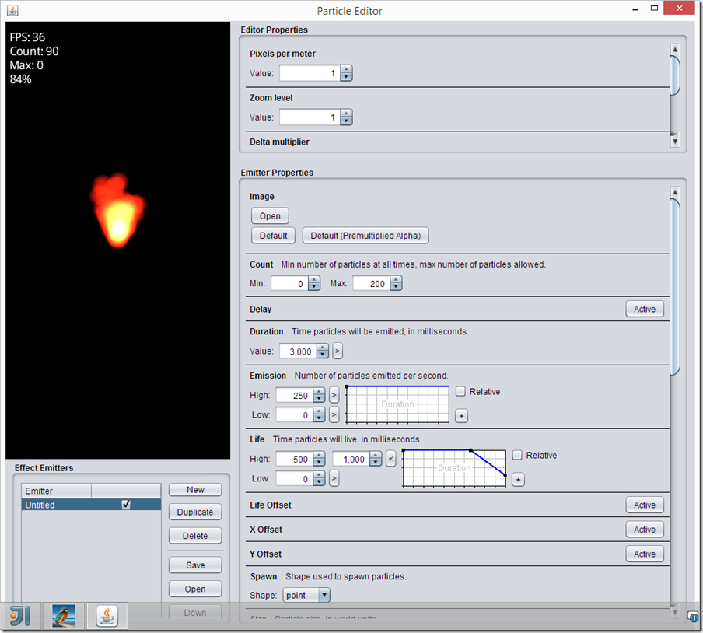
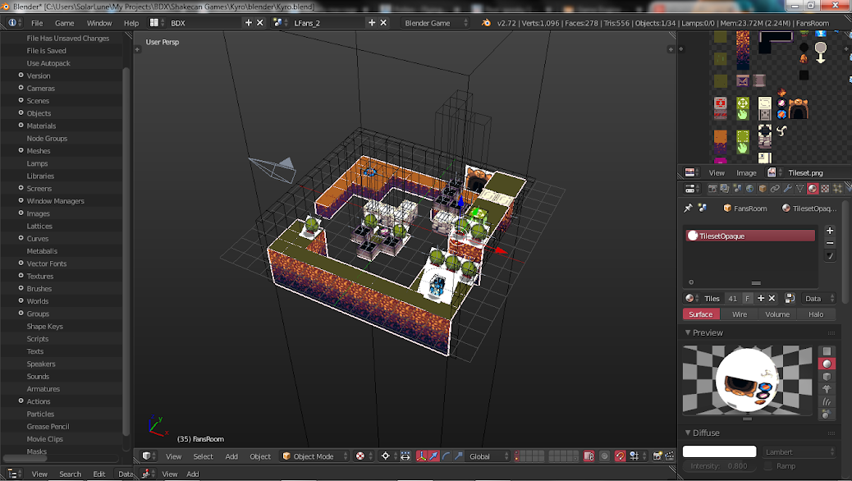
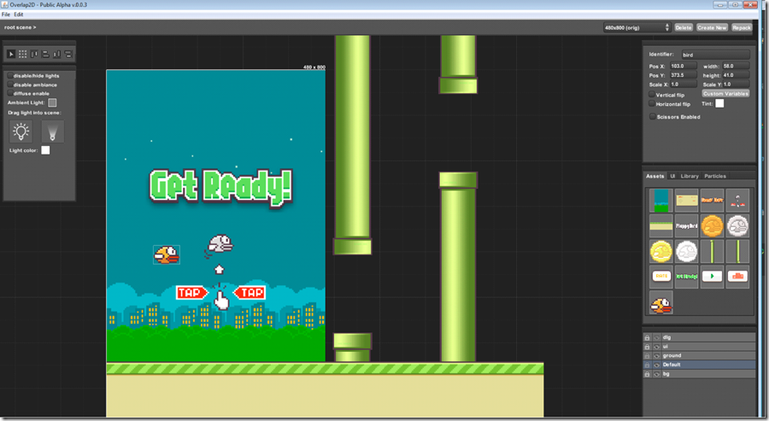

Slide 11
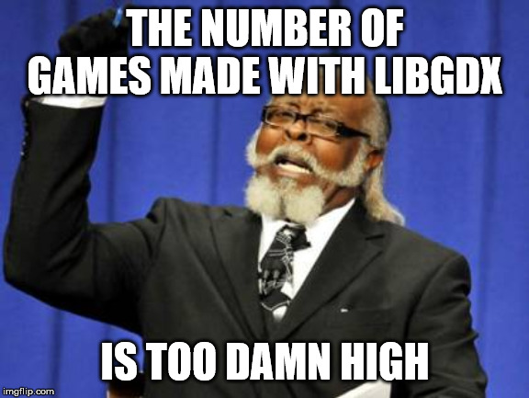
LibGDX Game Examples
Notes:
https://itch.io/games/made-with-libgdx
https://libgdx.info/

Slide 12
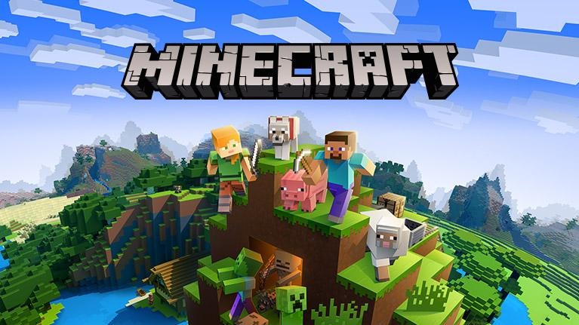
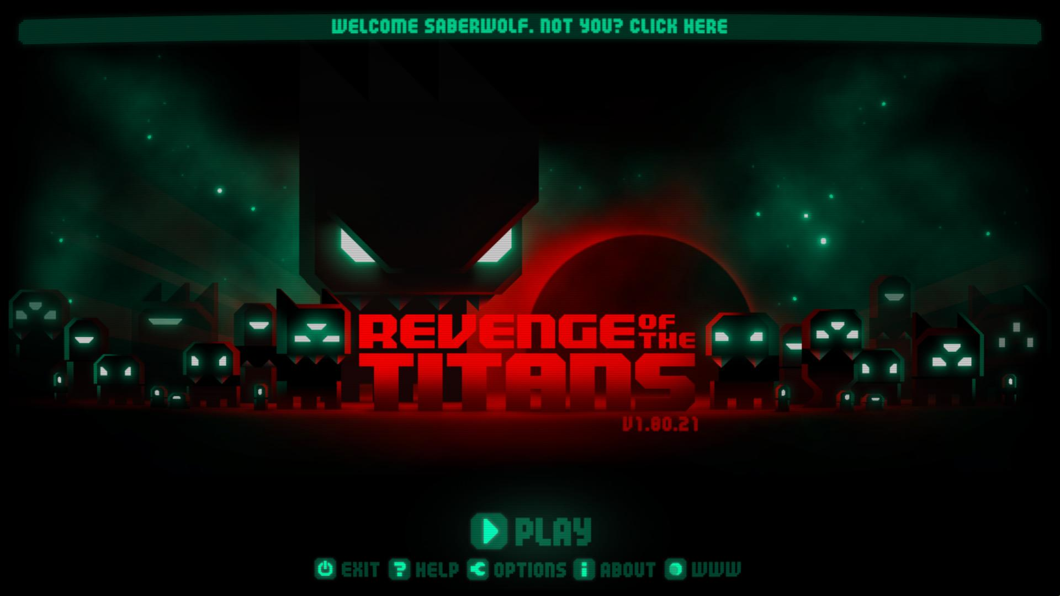
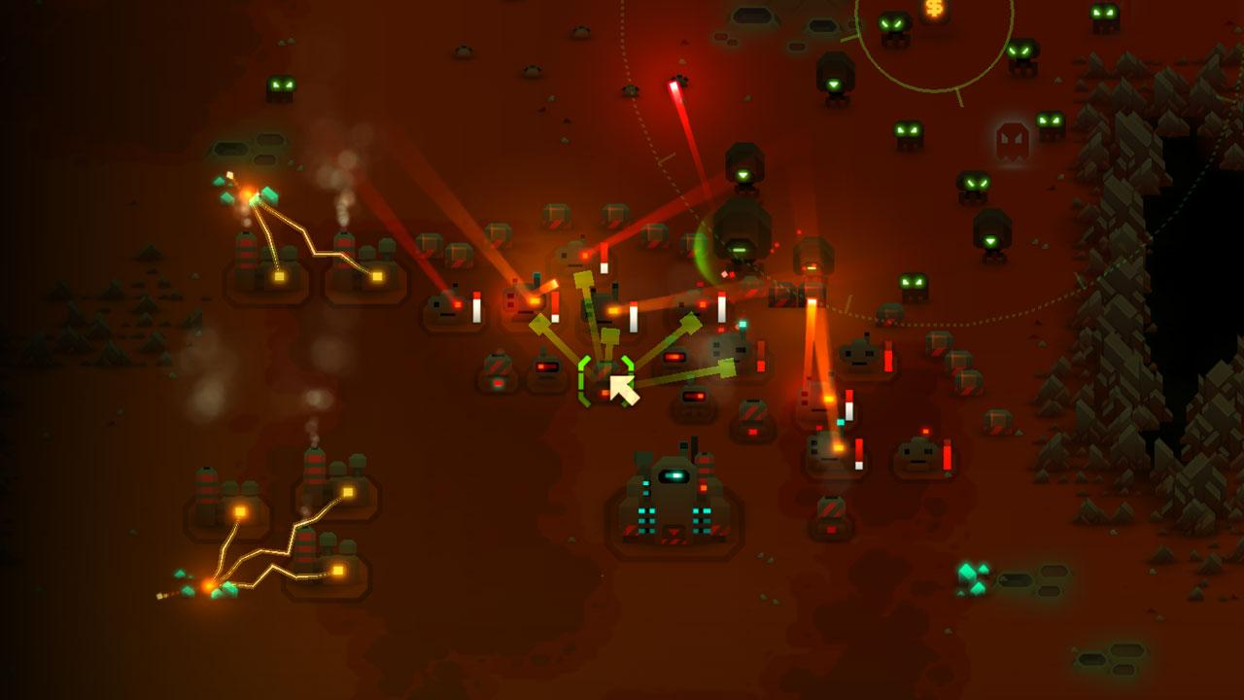
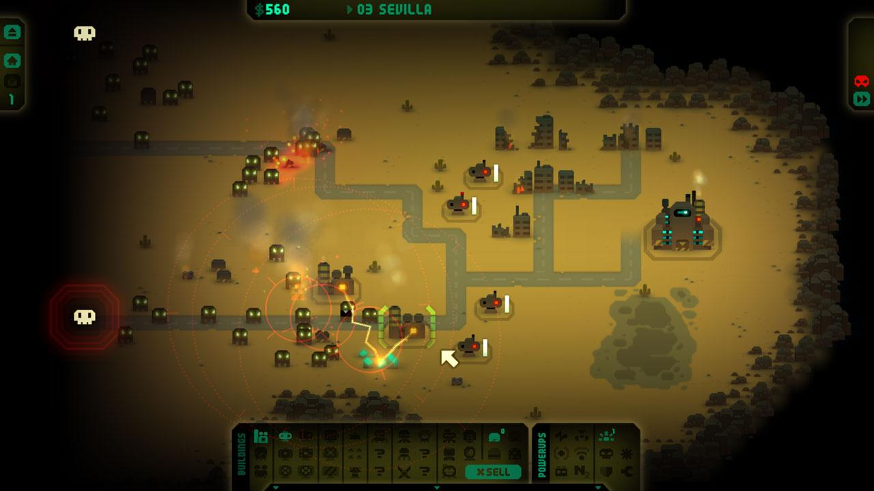
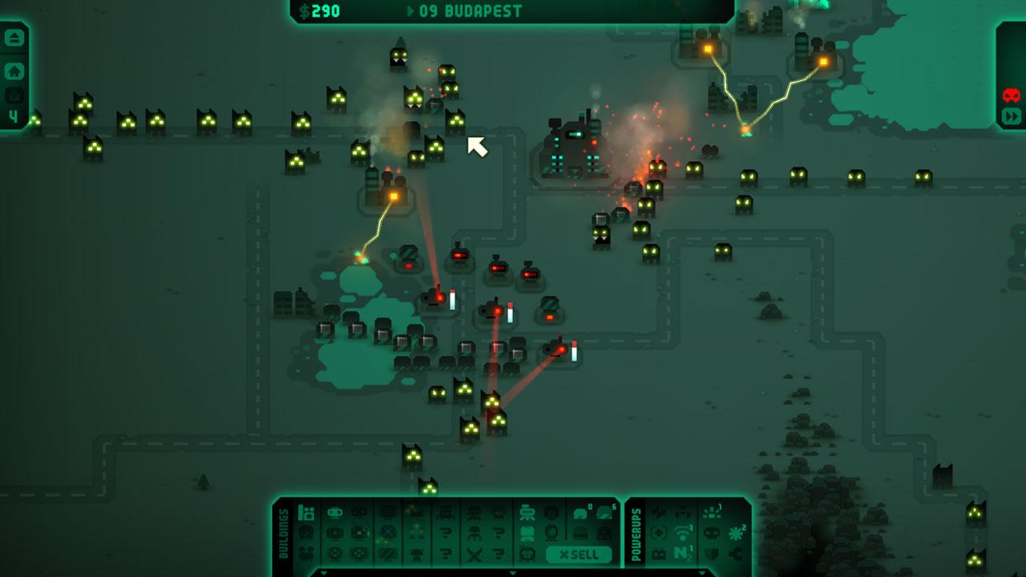
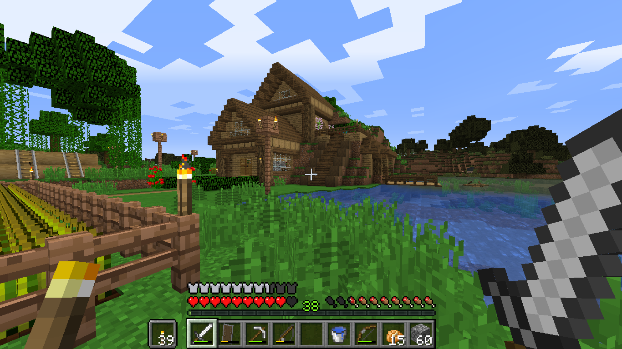
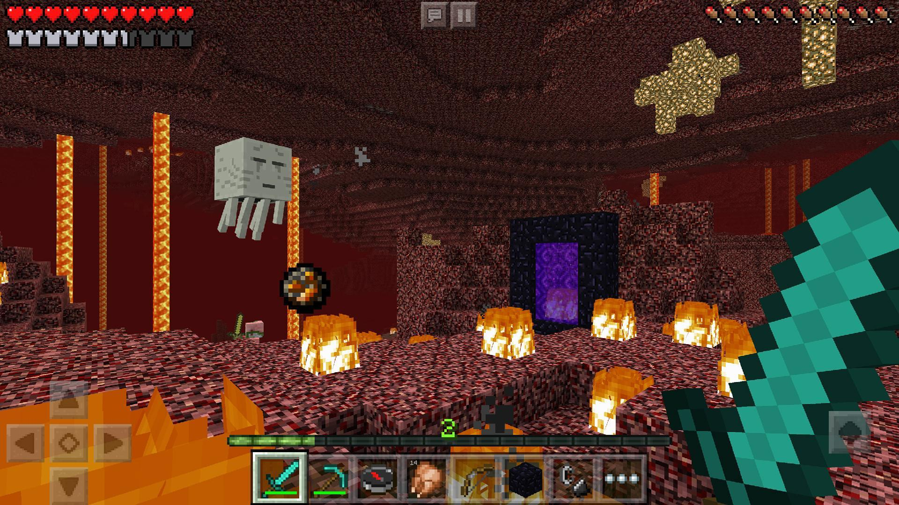
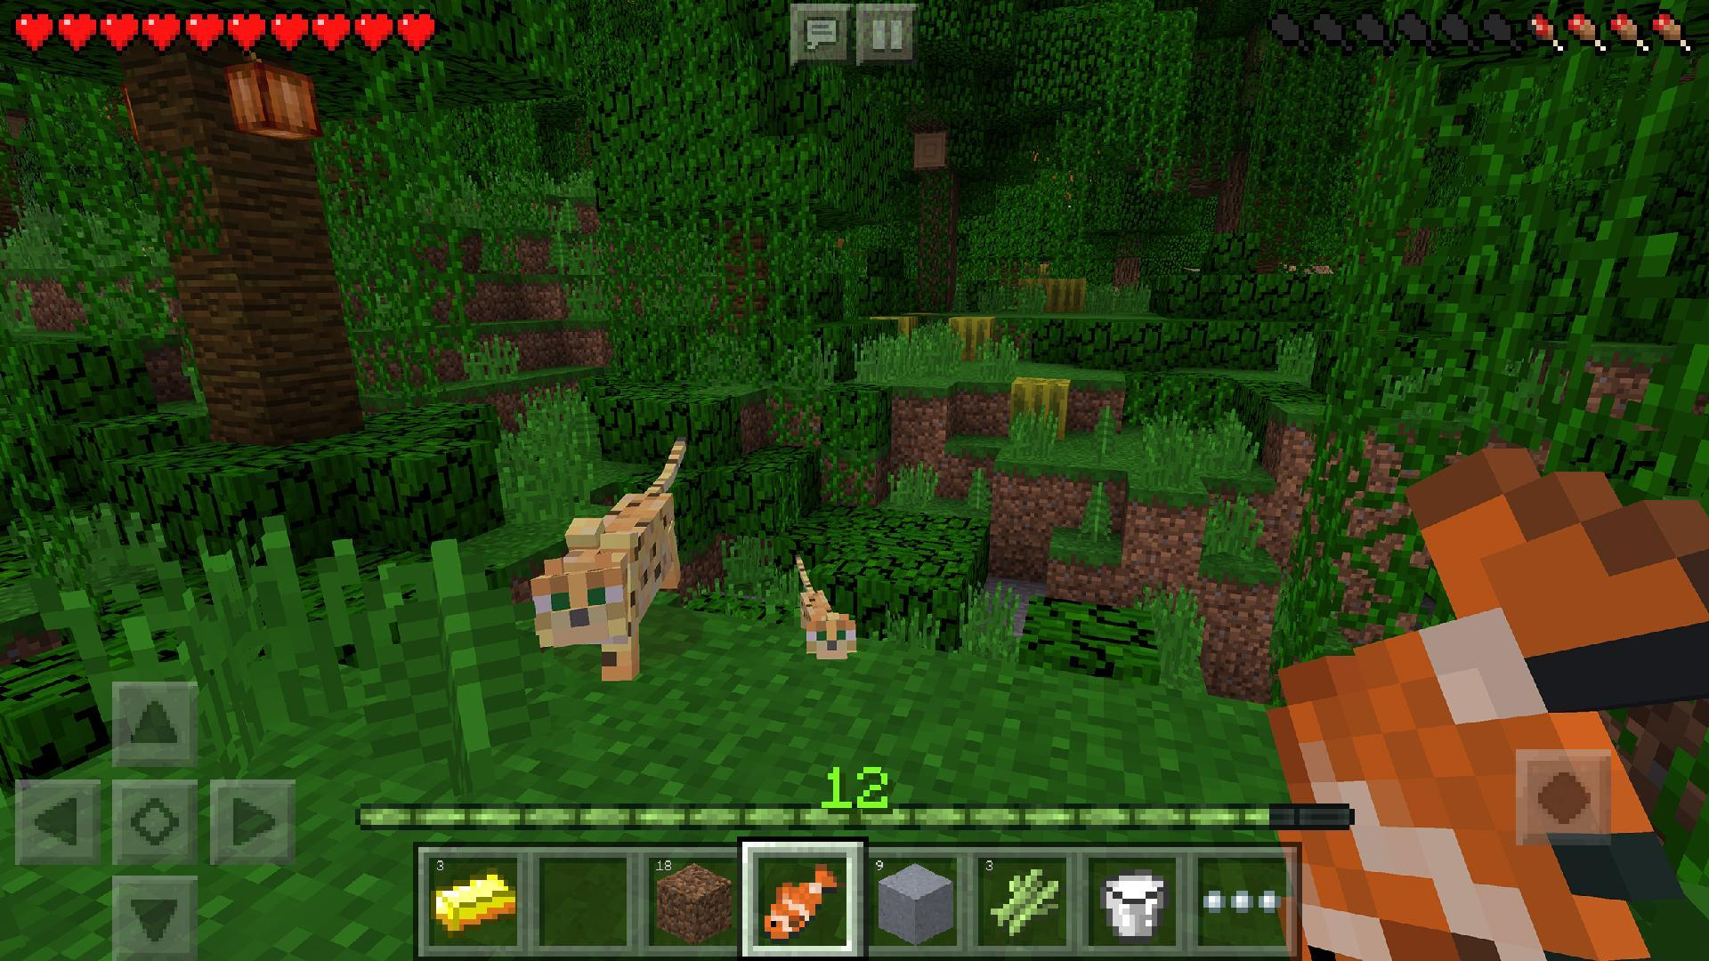
LWJGL Game Examples

Slide 13
Common Game Development Concepts in Game Engines & Game Libraries

Slide 14
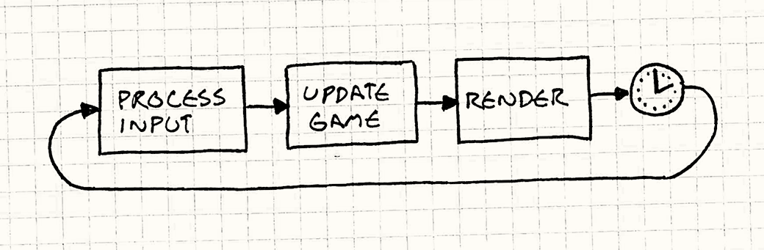
Game Loooooop
Initialize, Update and Draw
Update Entities Within the Game
Frames per second
while (true)
{
double start = getCurrentTime();
processInput();
update();
render();
sleep(start + MS_PER_FRAME - getCurrentTime());
}
while (true)
{
processInput();
update();
render();
}

Slide 15
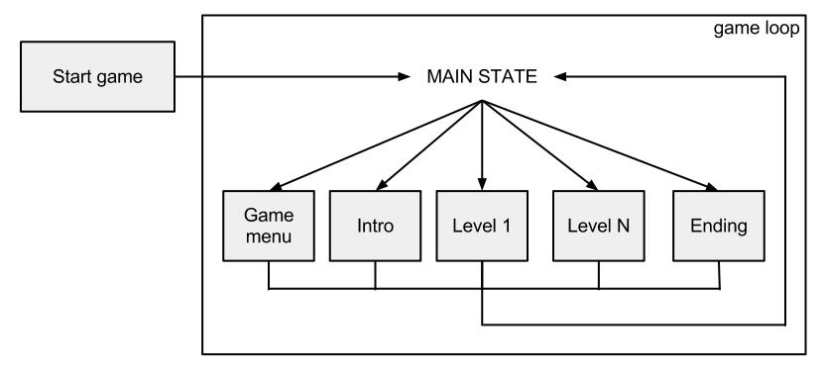
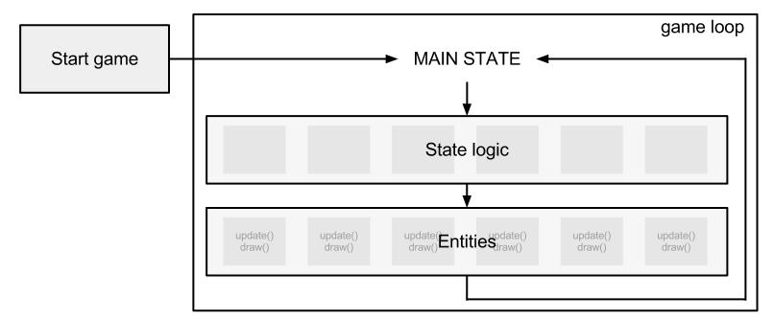

Slide 16
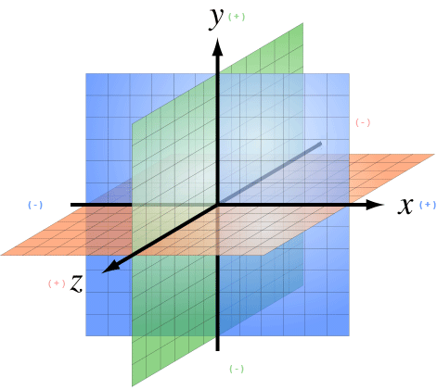
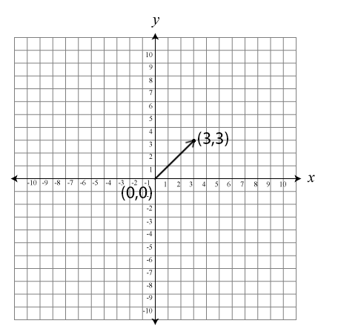
Transformations, coordinate systems & Vector Math

Slide 17
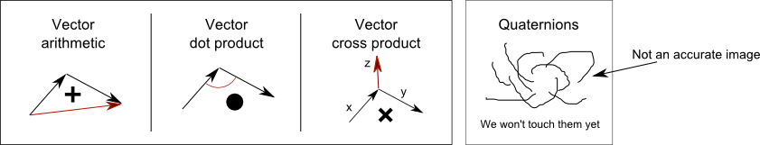
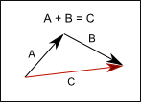
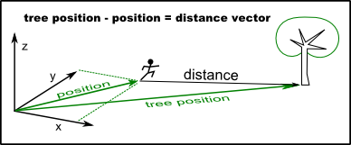
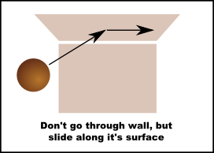
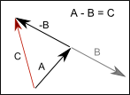

Slide 18
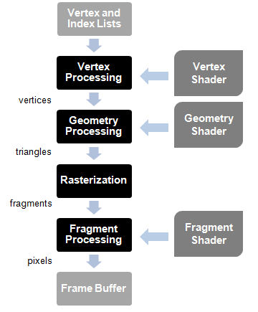
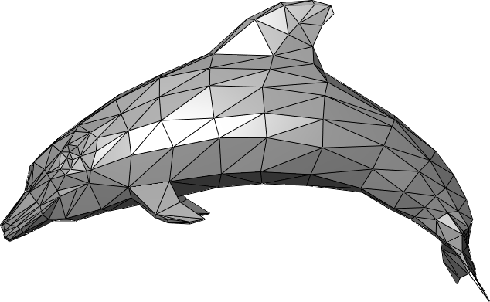
Models and Render Pipeline

Slide 19
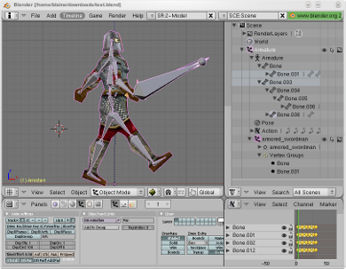
Animations and Character Rigging
Animation clip
Interpolation
key poses/frames
Fbx model format
Rigging & T-Pose
Notes:
Connecting key poses with straight lines is called linear interpolation.

Slide 20
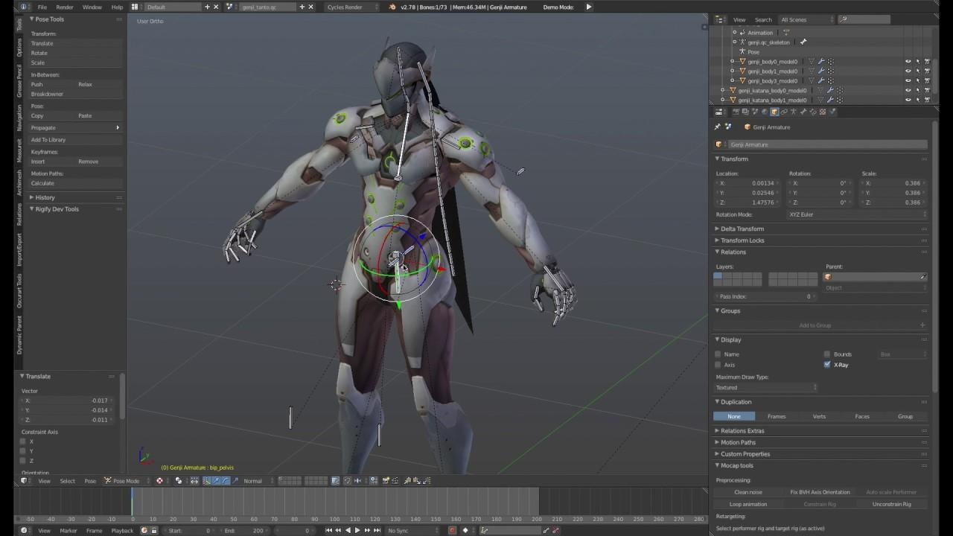
Character Rigging and T-pose

Slide 21
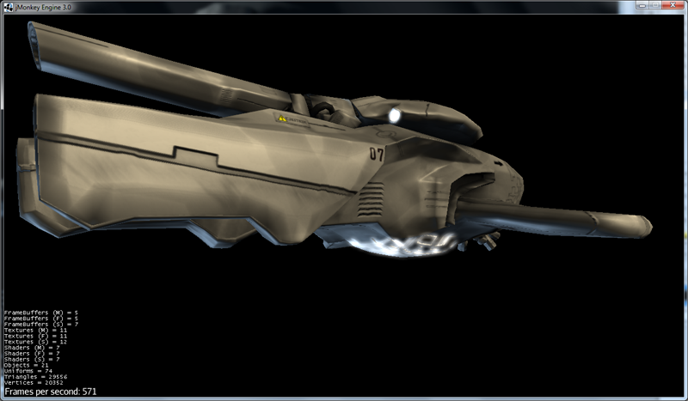
Materials: Color, Lighting/Shading
Color
Ambient color
Diffuse color
Light Sources
Emissive color
Reflections
Shininess
Specular Color

Slide 22
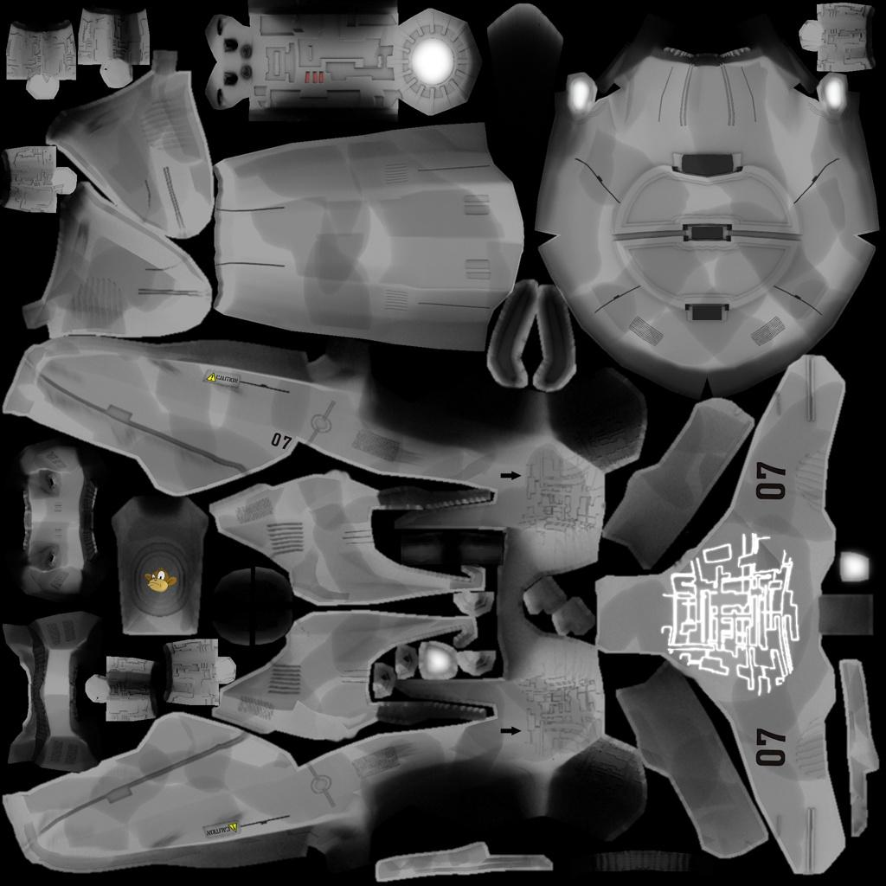
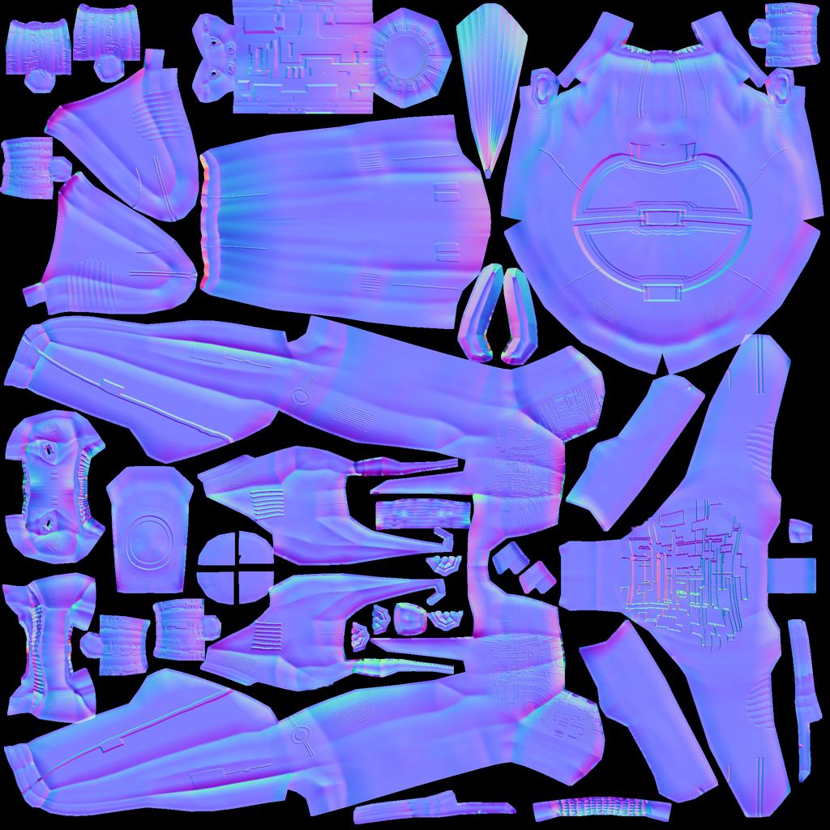
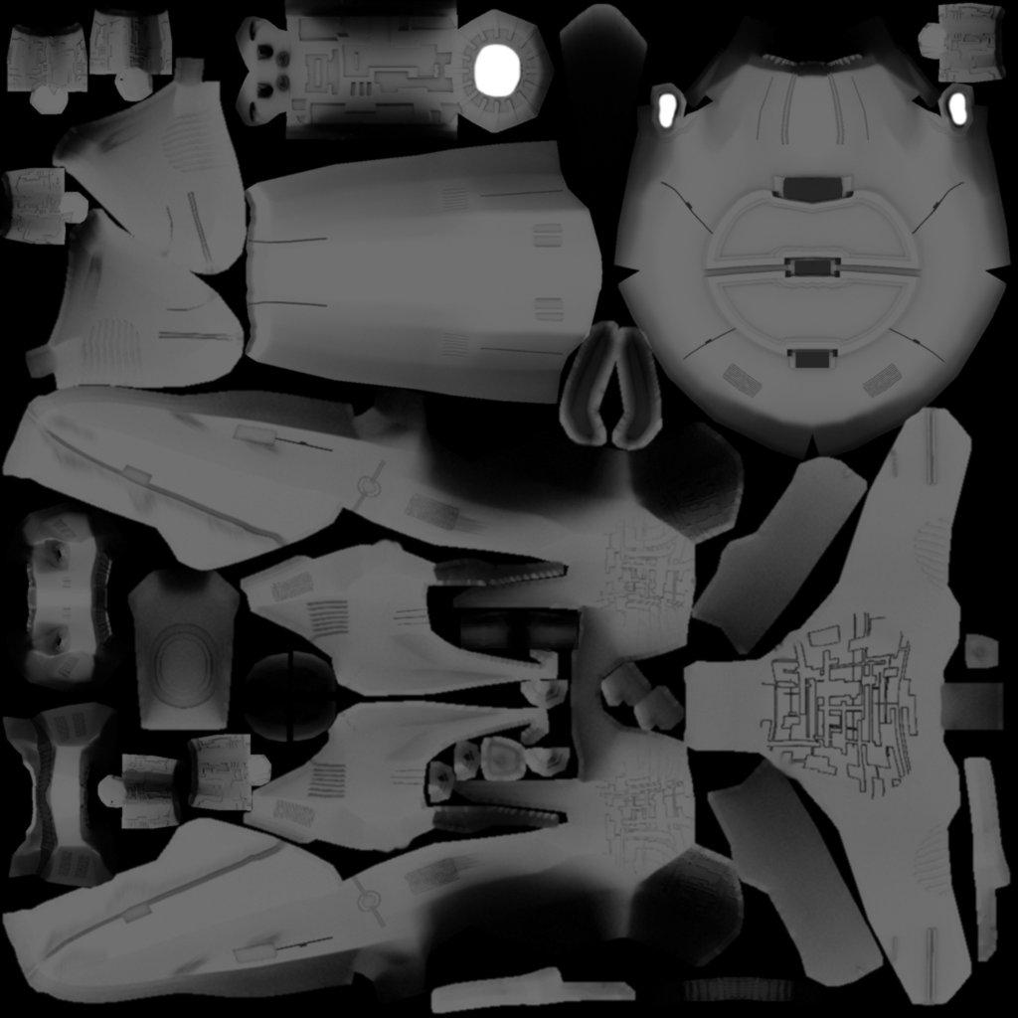

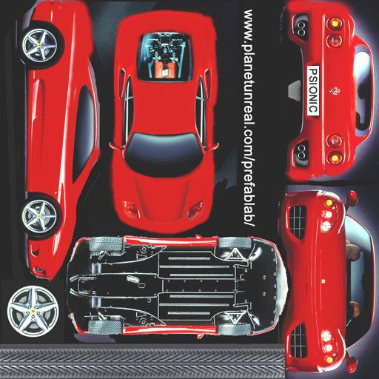
Color Map / Diffuse Map
Specular Map
Normal Map
Height Map
UV Maps / Texture Atlas

Slide 23
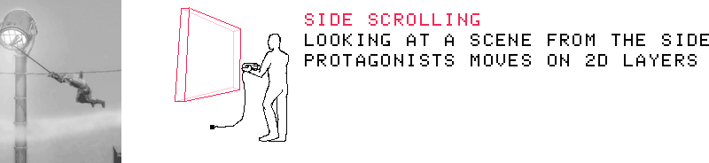

Camera perspectives in games

Slide 24




Slide 25

Object-Oriented Programming for Game Development
write code that can be easily modified and maintained.
organize code.
easier to maintain and modify.
Objects hold information about state and behavior.
States are the characteristics of the object.
Behaviors are the things the object can do.
Notes:
write code that can be easily modified and maintained.
organize code.
easier to maintain and modify.
Objects hold information about state and behavior.
States are the characteristics of the object.
Behaviors are the things the object can do.

Slide 26

What are Examples of Entities ?
A ship has states of:
rotation
momentum
thrust
and behaviors of:
turning
moving
firing
Asteroids
Notes:
The objective of Asteroids is to score as many points as possible by destroying asteroids and flying saucers. The player controls a triangular-shaped ship that can rotate left and right, fire shots straight forward, and thrust forward. As the ship moves, momentum is not conserved – the ship eventually comes to a stop again when not thrusting.
Think about what in this description could stand alone, or the things that are described that could have state and behavior. These become our objects.
The objects for Asteroids are: a ship, an asteroid, a flying saucer, and a bullet (can't forget those!). The cool thing about objects is that we normally describe things in terms of objects in everyday talk, so they usually reveal themselves through a description.
Think about what attributes describe the ship; these are its states. Then think about what the ship can do; these are its behaviors.

Slide 27

What are Examples of Entities ?
A Tetromino has states of:
rotation (in 90 degree units)
shape
color
and behaviors of:
falling
moving (sideways)
rotating
Tetris
Notes:
A random sequence of Tetrominos fall down the playing field. The objective of the game is to manipulate these Tetrominos, by moving each one sideways and rotating it by 90 degree units, with the aim of creating a horizontal line of ten blocks without gaps.

Slide 28

Pac-Man

Slide 29
“In the one and only true way. The object-oriented version of 'Spaghetti code' is, of course, 'Lasagna code'. (Too many layers).”
- Roberto Waltman

Slide 30
Thank You!

